Slide 1
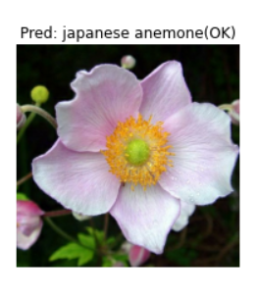
Flower image recognition
Yadan Tang
DSI-823 Capstone Project

Slide 2
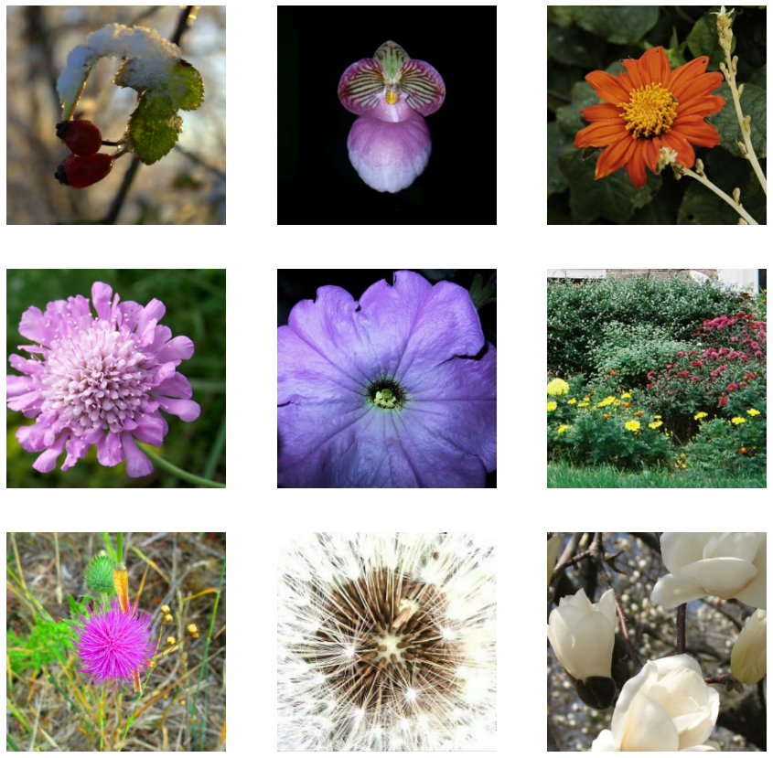

Do you know the names of the flowers?
On earth, there are:
5,000 species mammals
10,000 species of birds
30,000 species of fish
Astonishingly, over 400,000 types of flowers!
Many times, I found myself enjoying and recognizing the flower, but cannot name it!

Slide 3





There are many commercial Apps for flower/plants identification by submitting an image. My goal: to build a flower image classification model

Slide 4
Outline
Data Source:
Kaggle metal_to_petal multiclassification on TPU challenge(Class: 104 different types of flowers)
Tfrecord Data:
Train: 12753 images with labels
Val: 3172 images with labels
Test: 7382 images unlabeled
Image size: 331 x 331
EDA
Load Tfrecord dataset from GCS
Unpack images and labels/IDs and return as tuple
Image normalization
Image augmentation – Random change saturation and contrast, Random flip
Modeling
CNN baseline model
Xception pretrained model and hyper parameter fine-tune
Model prediction and evaluation
Display images with predicted and actual classes
Plot confusion matrix
Streamlit demo

Slide 5

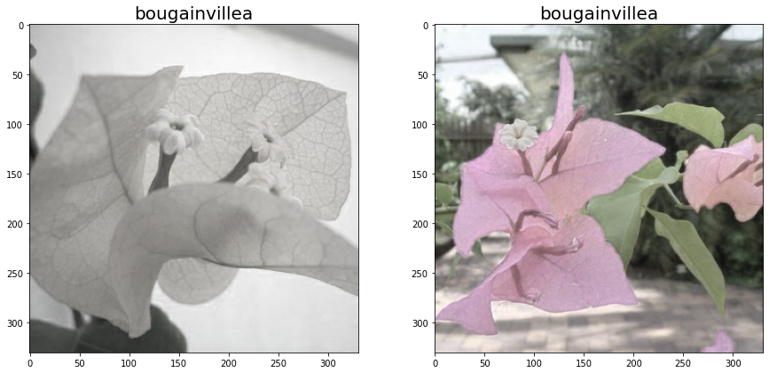
Image augmentation
Random alter saturation
Random flip

Slide 6
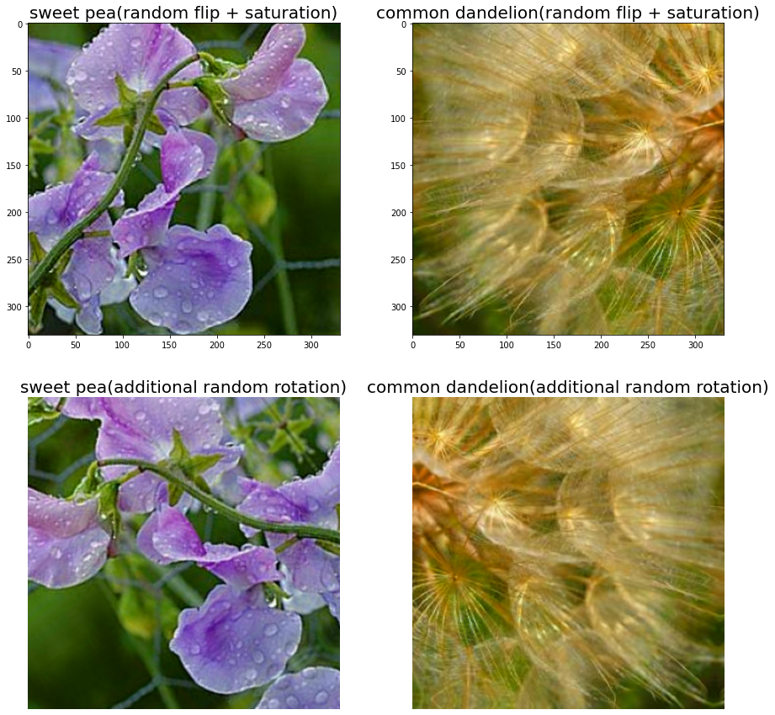
Additional Image Augmentation (via keras.layers)
Random rotation

Slide 7
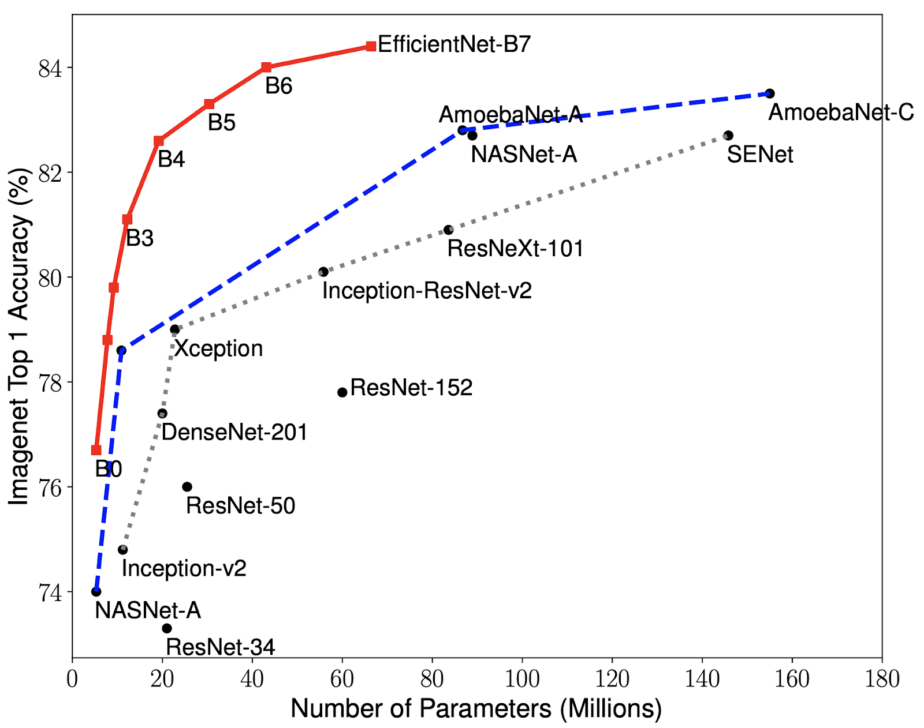
Xception pretrained model is chosen for image classification
Image sources
Notes:
Base modelresolutionEfficientNetB0224EfficientNetB1240EfficientNetB2260EfficientNetB3300EfficientNetB4380EfficientNetB5456EfficientNetB6528EfficientNetB7600

Slide 8
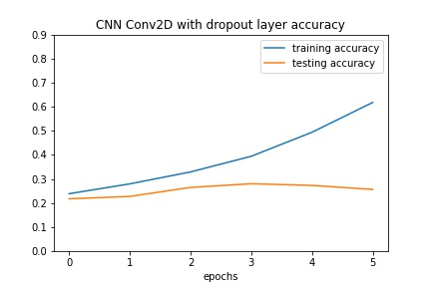
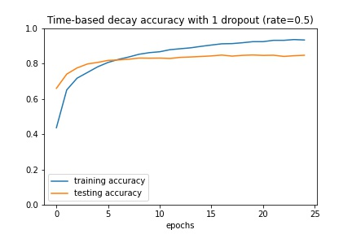
Xception pretrained model vs. CNN baseline model
Baseline CNN model
Val accuracy: 23%
Xception model:
85% validation accuracy, ~60% higher than baseline CNN model (23%)
Better control on overfitting
Xception pretrained model
Val accuracy: 85%

Slide 9
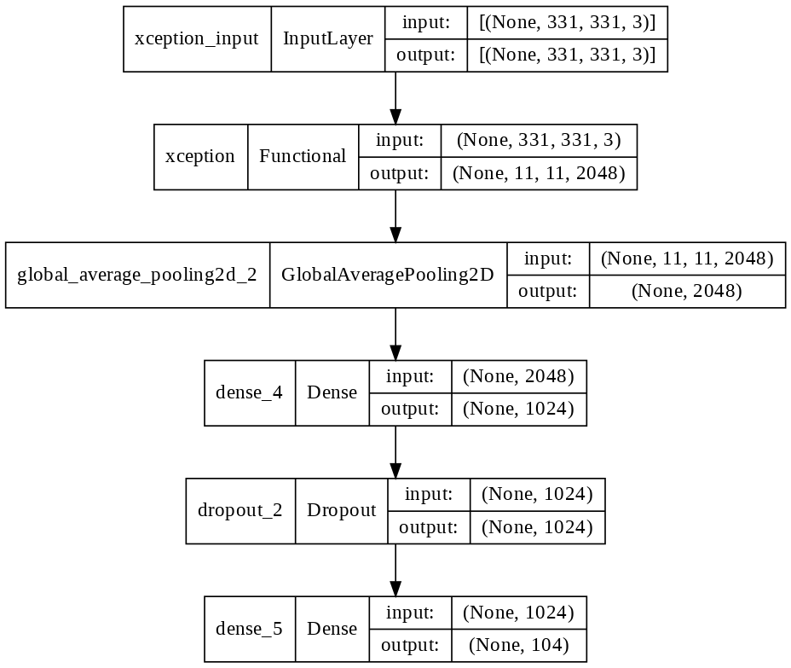
Xception Model structure

Slide 10
Hyperparameters impact on model
Pretrained weights
Learning rate LR algorithms
Drop layers and rates
Image augmentation

Slide 11

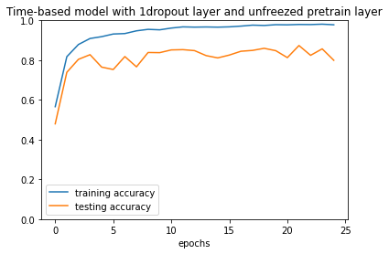
Pre-trained model weights
Pros :
More stable performance on val
Control overfit
Trainable=False
Trainable=True

Slide 12
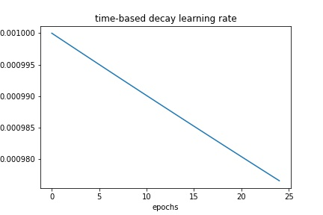
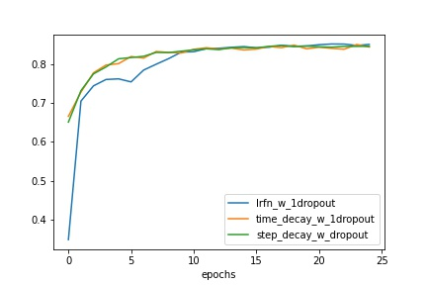
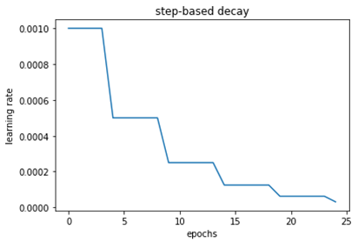
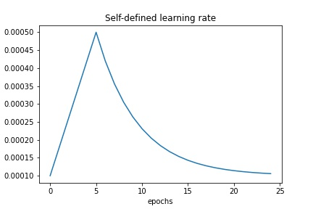
Learning Rate(LR) Algorithms have minimal impact on val accuracy
LRs
Val Accuracy of 3 LRs
Time_based decay
Step_wise decay
Self-defined LR
Self-defined LR decay

Slide 13
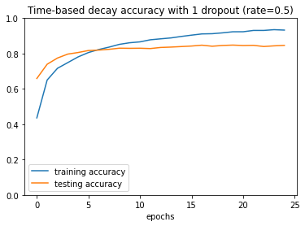
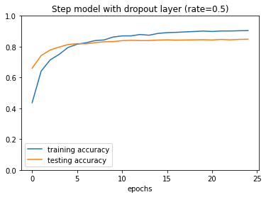
Time-based decay vs. Step-wise decay
With similar val accuracy, step-wise decay outperform time-based decay in more effectively control of overfit
Time-based decay
Step-wise decay

Slide 14
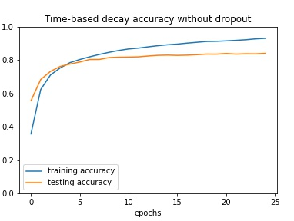
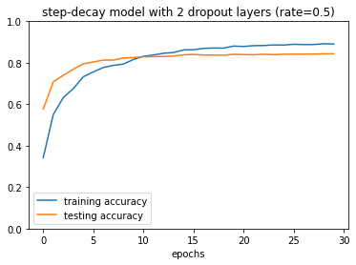
Dropout Layers
Dropout layer helps to control overfit, also improved validation accuracy for 1-2%
2 dropout layers with (rate =0.5) does not improve val accuracy, but further control model overfit
No drop
1 drop(rate=0.5)
2 drop(rate=0.5)

Slide 15
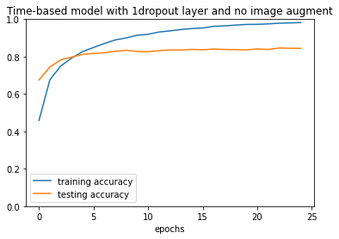
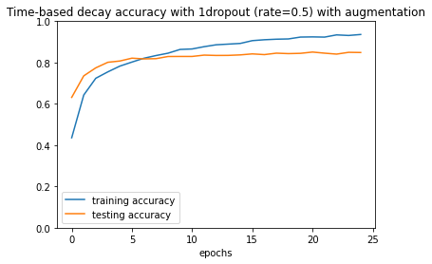
Image augmentation help control overfit
No image augment
With image augment

Slide 16
Impact of hyperparameters on model performance
60%
CNN vs Pretrained model
Significant improvement as compared to CNN baseline
Image augmentation (rotation, flip)
<1%
Minimal increase in val accuracy
Controls overfit
~1-2%
Dropout layer/rate
<1%
Dropout layer(s) control overfit
Optimum layer = 2 and drop_rate = 0.5
Learning rate(LR)
Time-based, step-based has better val accuracy than self-defined LR at lower epochs
Step-wise has the best control in overfit

Slide 17
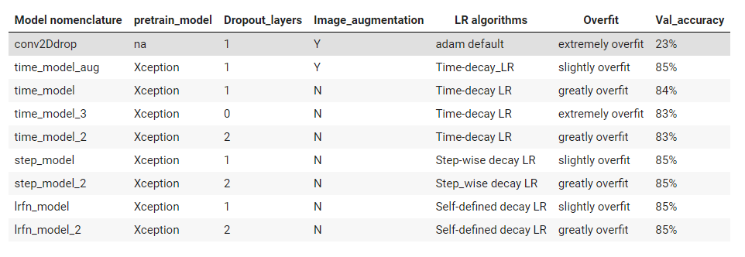
Model performance summary

Slide 18
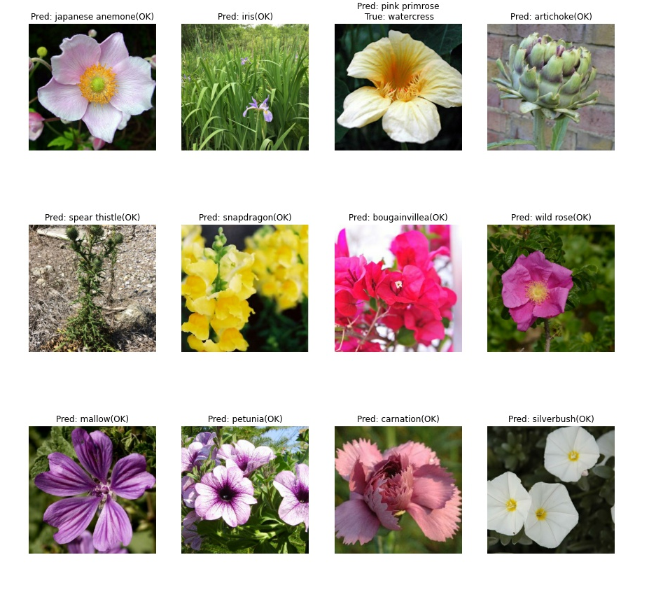

Slide 19
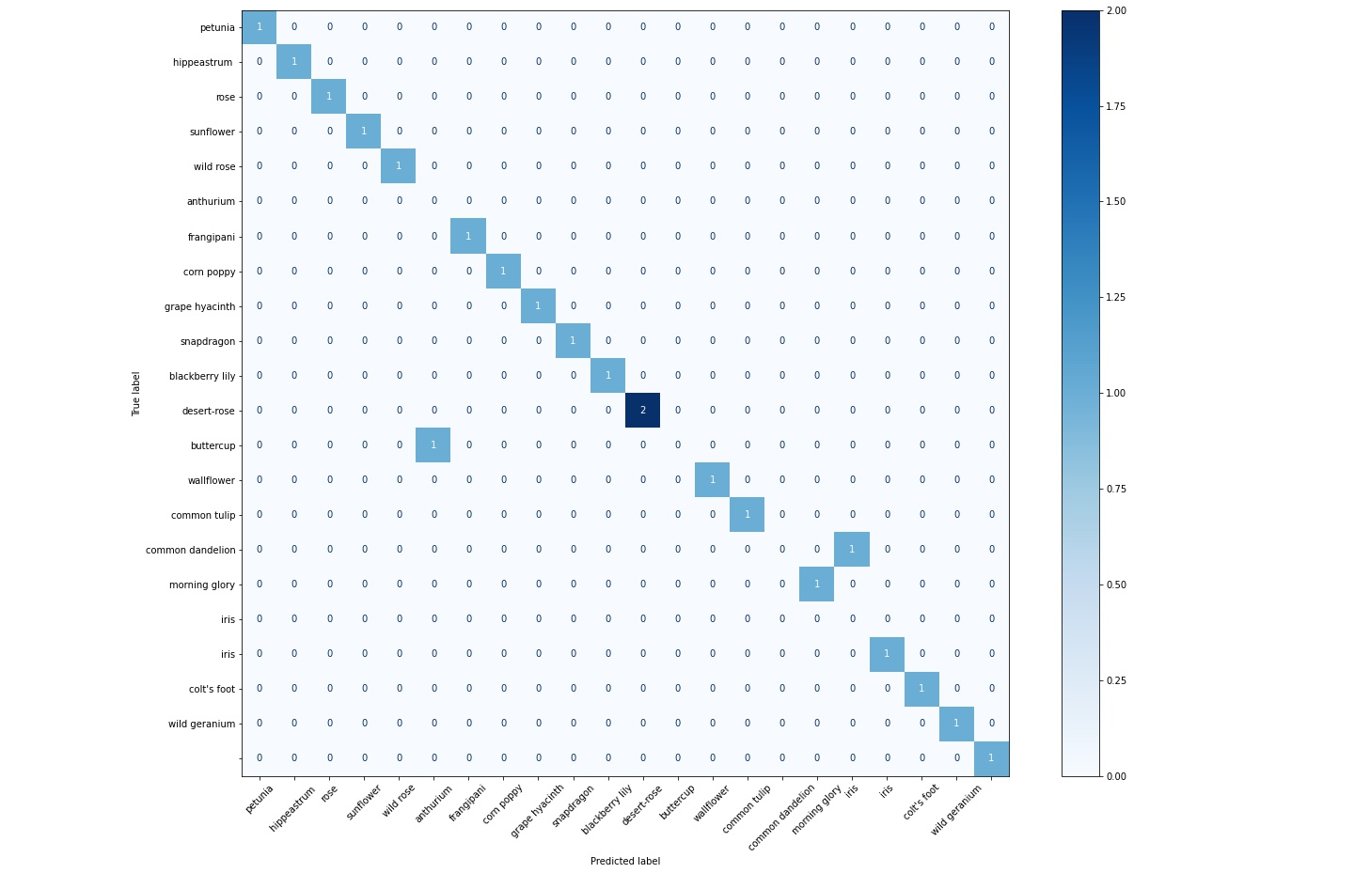

Slide 20
Time for streamlit demo

Slide 21
Conclusion
I really enjoy image recognition and learn how to utilize TPU and play with the hyperparameters. I am happy to develop a model with 85% val accuracy which outperform a baseline CNN model by over 60%.
Key takeaways:
Xception model (85% val accuracy) with pretrained weights outperform baseline CNN model(23% val accuracy)
Preserved pretrained weights has more stable performance and better controls overfit
Drop layer( rate=0.5) only improves val accuracy by 1–2%, but effective in controlling overfit. 2 dropout layers does not influence val accuracy, but further help control overfit.
Image augmentation also has minimal improvement on val accuracy, but effective in controlling overfit.
Learning rate algorithms (time-based, step-wise, self defined LR) have similar val accuracy after reaching stable performance, however, step-wise model leads to a less overfit model as compared to other LRs (if other parameters remain the same).

Slide 22
Credits
Credits to the following resources which inspired and educated me
Special Thanks to Caroline S. and Adi. B for consulting and tips
GCS connection with Colab instructions [link]
Tensorflow callbacks documentation [Documentation link]
Tensorflow image processing documentation [Documentation link]
Modeling using Keras image recognition pretrained model [Robert Border][Umar Farooq]
Learning rate scheduler and callback functions [Bachr Chi][Udacity PyTordh Chllengers]
Streamlit for keras model [streamlit documentation][Jalal Manssori][Nachiketa Hebbar]

